Slide 1
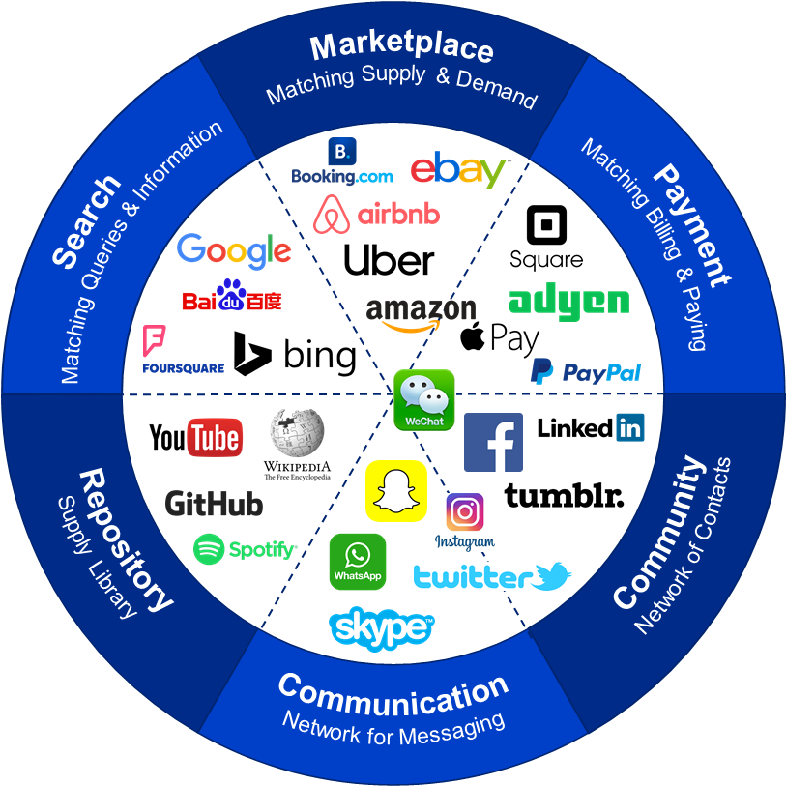
©Ron Meyer, 2019

