Slide 1
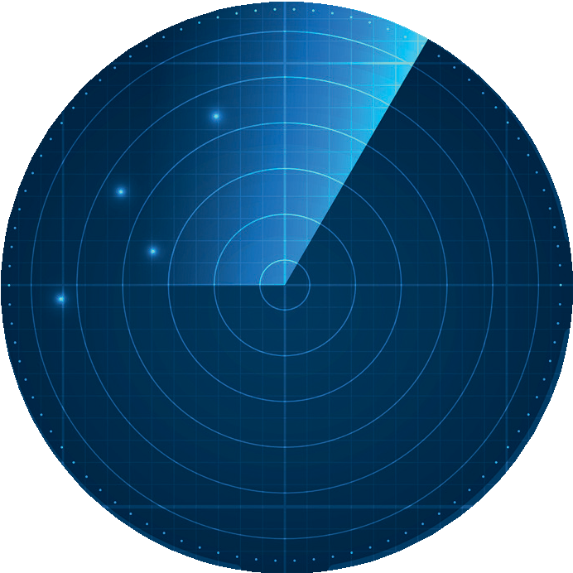
Striving for
Achievement
Striving for
Virtue
Striving for
Achievement Status
Striving for
Virtue Status
Striving for
Power Status
Striving for
Affiliation Status
©Ron Meyer 2020
Striving for
Power
Striving for
Affiliation

