Slide 1
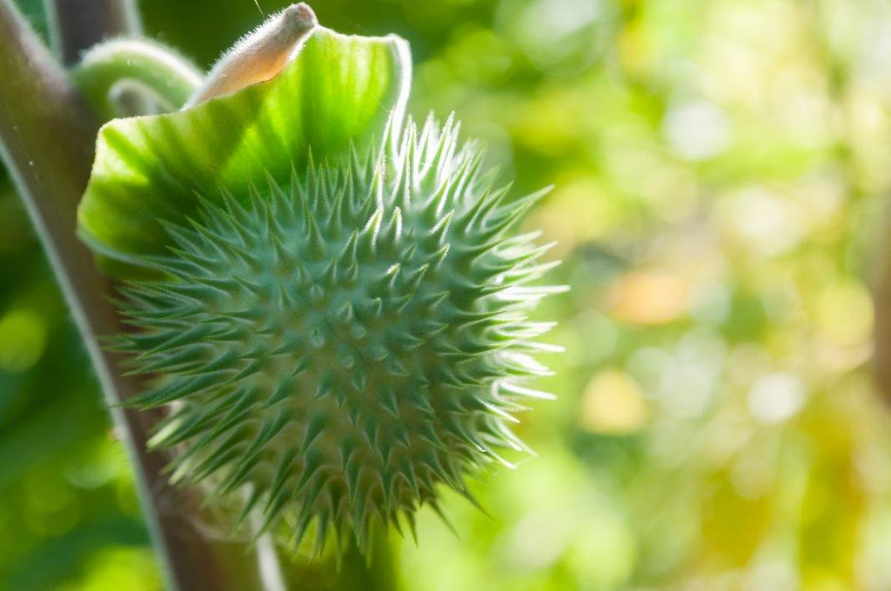
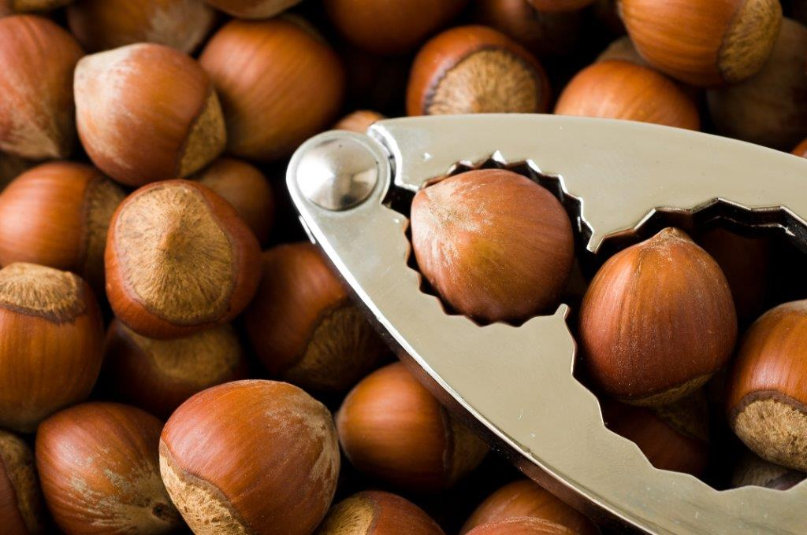
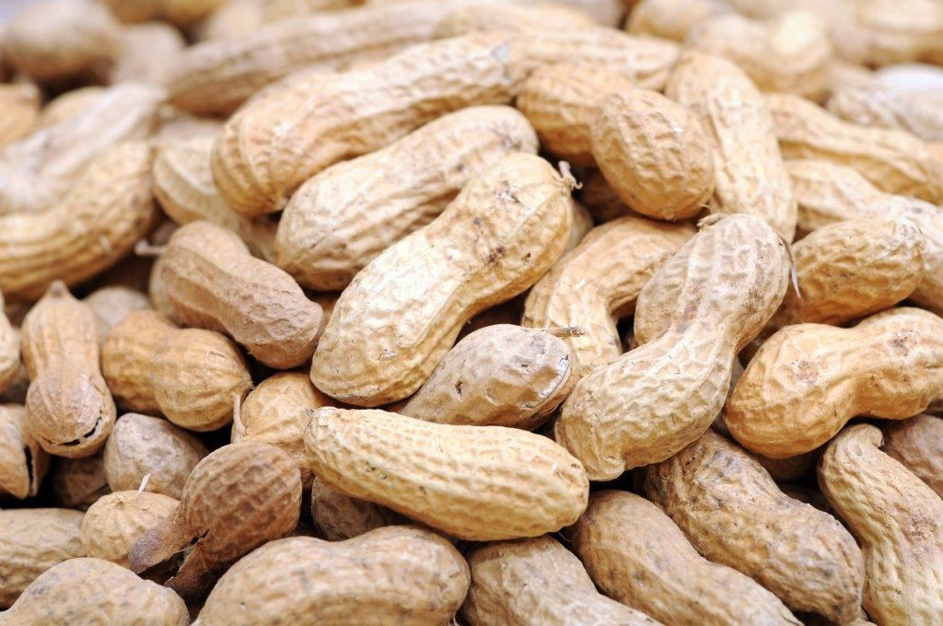
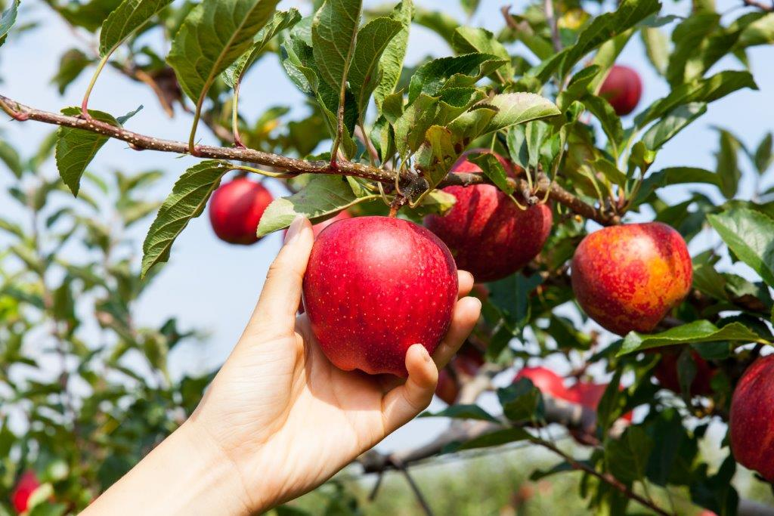
High/ Hard
Poison
Fruit
Tough
Nuts
Execution Effort
Low
Hanging
Fruit
Peanuts
Low/ Easy
©Ron Meyer & Ronald Meijers 2018
Low
Execution Value
High

